Slide 1
BYPASS GASTRICO CON FUNDECTOMIA E STOMACO ESPLORABILE
Dott. Luigi Romeo
U.O. chirurgia generale riccione
direttore dott. Andrea lucchi

Slide 3
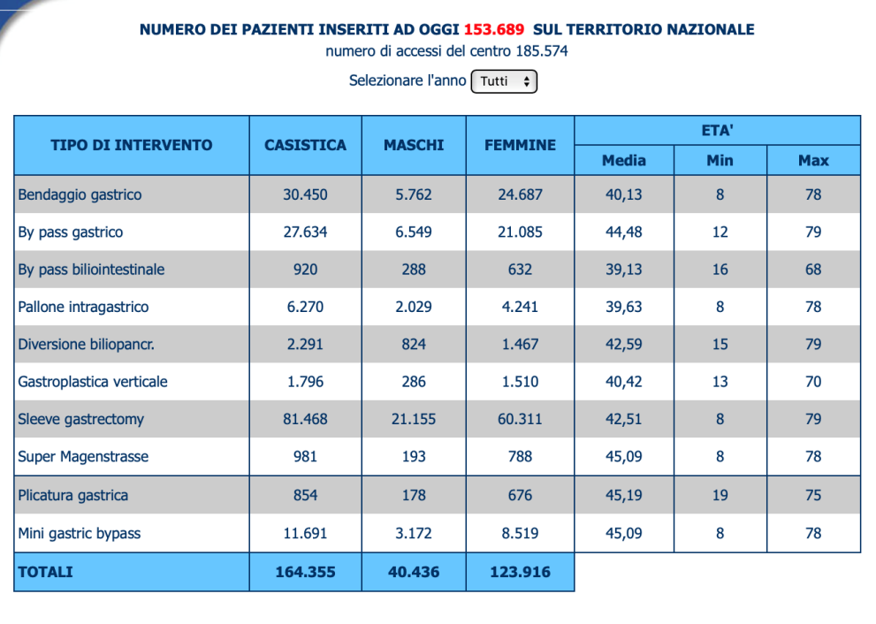
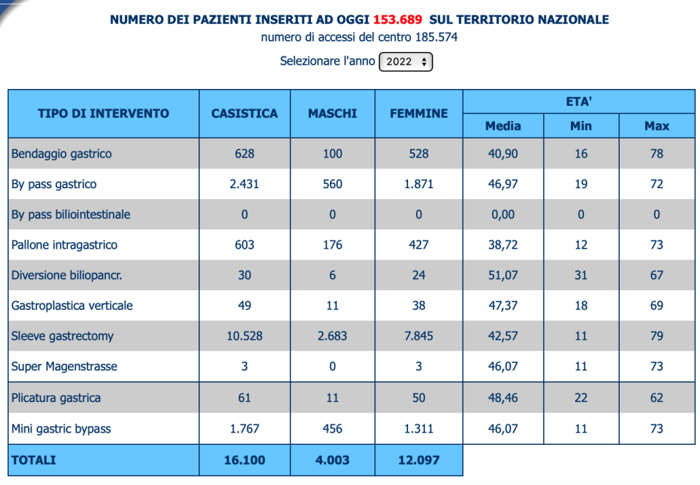
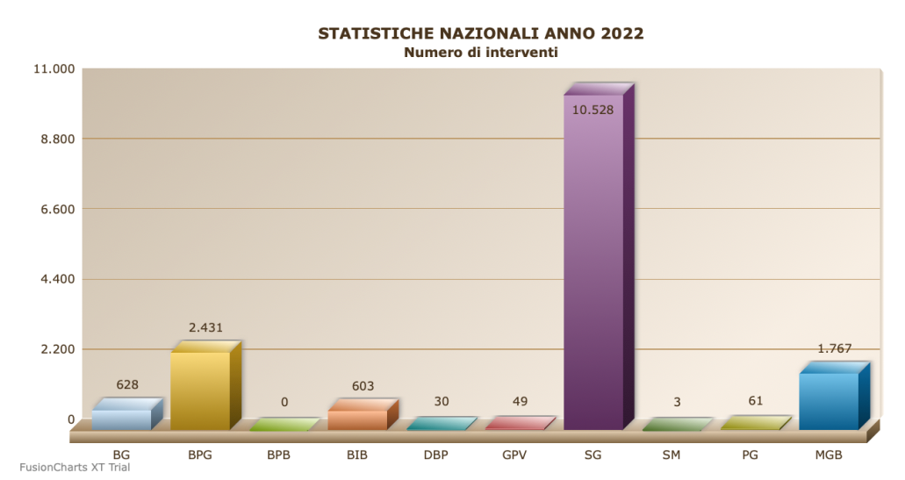
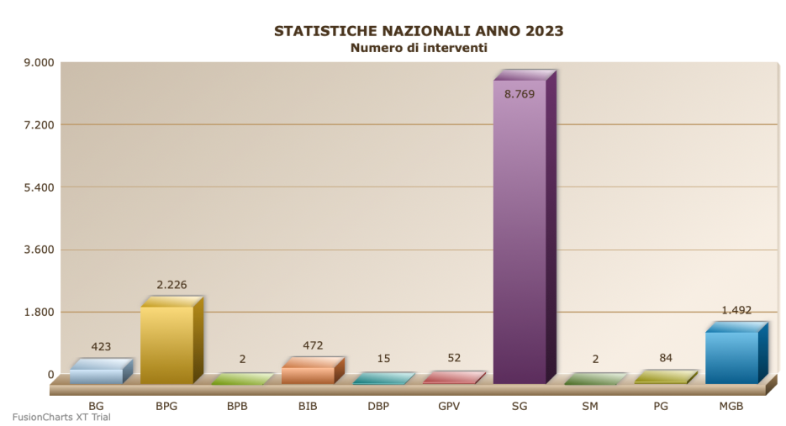
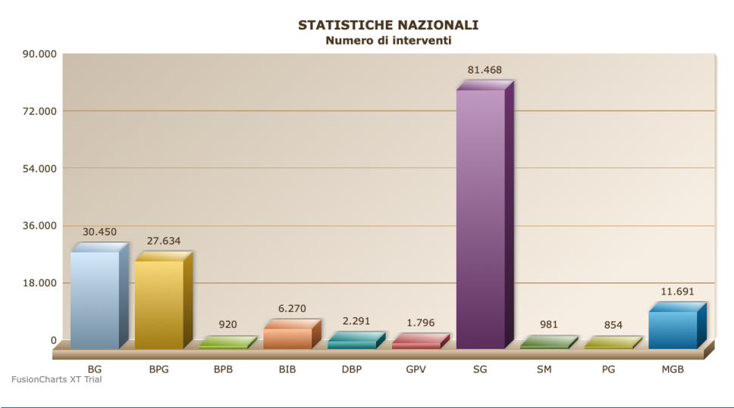

Slide 4
Gastric remant, duodenum, CBD after RYGB
-Tumor
-Common bile duct lithiasis exploration
-Acute complications: bleeding, perforation, necrosis

Slide 5
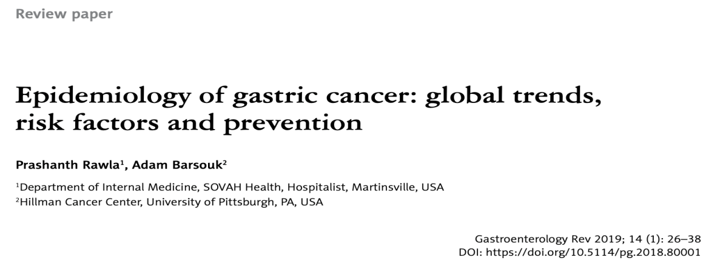
Gastric cancer is the third leading cause of cancer-related death worldwide, with about 33.3% of patients having a 5-year survival rate. One of the main reasons for the significantly low survival rates is associated with late diagnosis.
Roma, 2 ottobre 2022 – I principali tumori del tratto gastro-intestinale colpiscono ogni anno 78mila uomini e donne nel nostro Paese. Nello specifico si registrano 43.700 casi di tumore del colon-retto; 14.500 allo stomaco; 14.300 al pancreas e 5.400 colangiocarcinomi
La neoplasia gastrica rappresenta la quarta causa di morte in Italia, con particolare incidenza nell’ appennino tosco-romagnolo

Slide 6
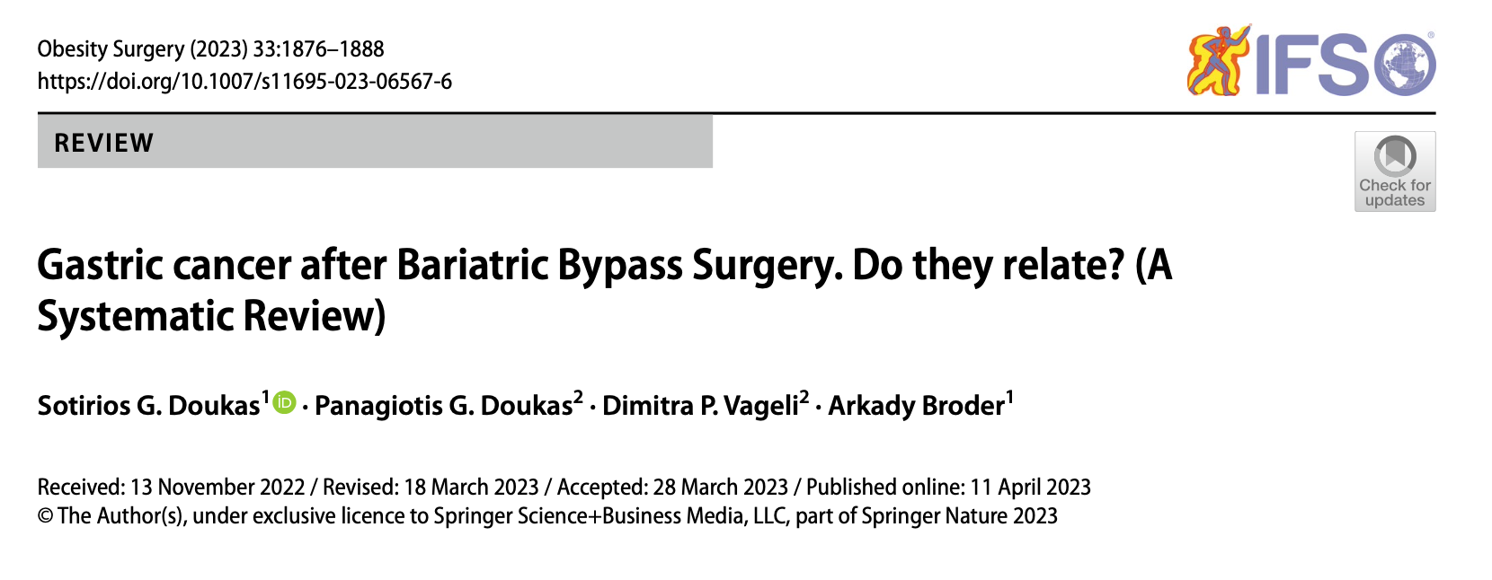
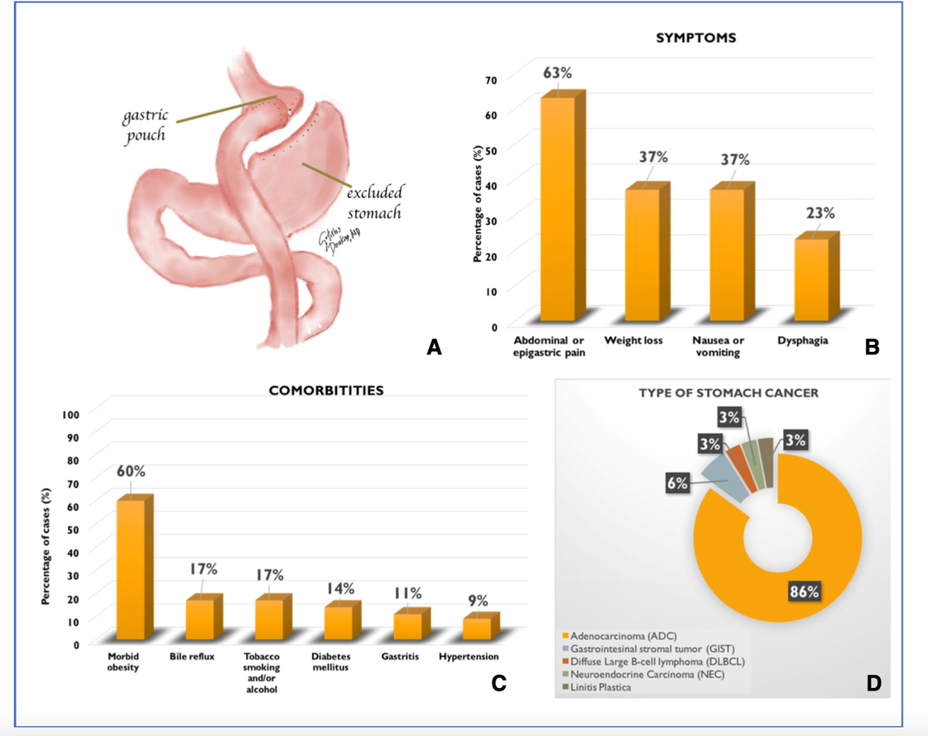

Slide 7
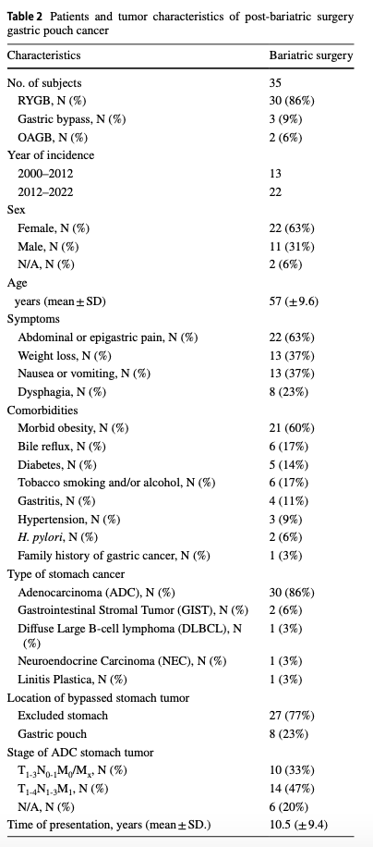
-30 articles
-35 cases, including 30 cases after RYGB.
-increasing trend (41%) in the number of published stomach cancer patients with a previous bariatric procedure in the last decade (22 cases in 2012–2022 versus 13 cases before 2012)
-Post-bypass gastric cancer was described in 27 (77%) cases in the bypassed or excluded stomach
--Most of the excluded stomach tumors (55%) were identified by exploratory laparotomy or laparoscopy
-In 33.3% of cases examined, the excluded stomach could be approached endoscopically. Double-balloon enteroscopy was used in only one of the cases
-Most of the tumors were adeno- carcinomas (ADC) (86%), followed by gastrointestinal stro- mal tumors (GIST) (6%), diffuse large B-cell lymphoma (DBCL) (3%), neuroendocrine carcinomas (NEC) (3%) and a rare gastric linitis plastica tumor (3%) were also identi- fied
-considerable proportion of tumors with evidence of local or distant metastasis (47%). The mean time of tumor presentation was 10.5 years

Slide 8
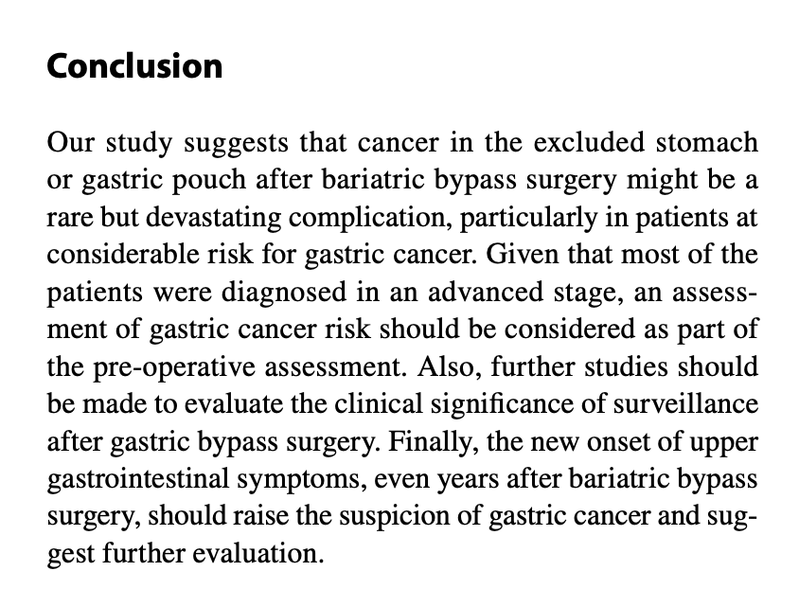
Risk factors for gastric cancer
-H. pilory
-history fo gastric cancer
-tobacco
-bile reflux
-n-nitrosamine
-changes in gastric and intestinal microbiota following gastric bypass
-obesity (pre-malignant molecular alteration previous to weight loss)

Slide 9
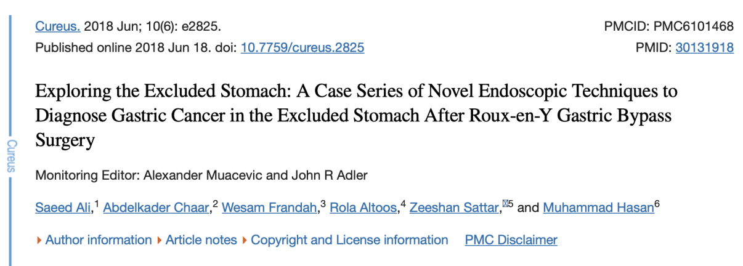
Gastric remnant diagnosis
Percutaneous endoscopic gastrostomy (PEG), percutaneous endoscopic transgastric jejunostomy (PEG-J), and direct percutaneous endoscopic jejunostomy (DPEJ)
Double balloon enteroscopy
Intragastric single-port surgery (IGS) accesses the gastric remnant

Slide 10
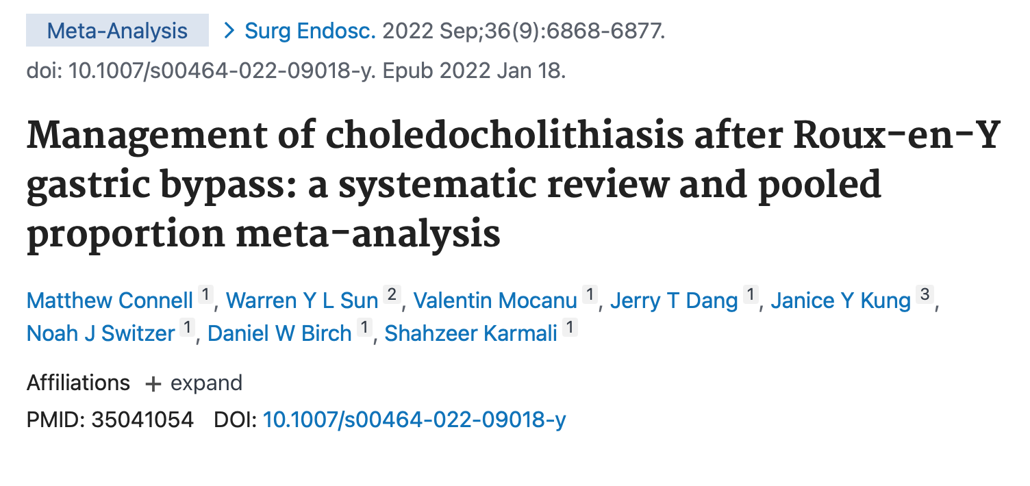
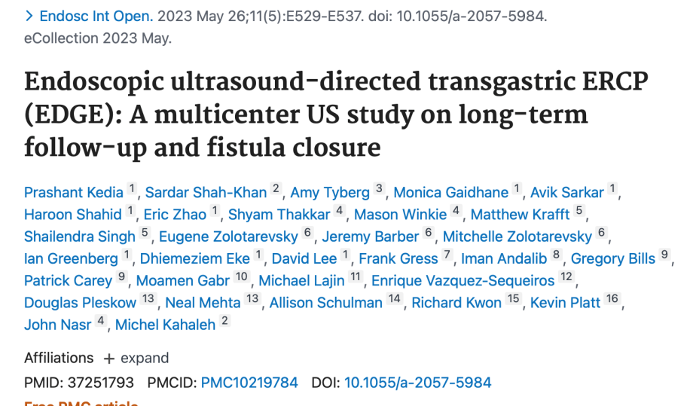
Choledocholithiasis management after RYGB
laparoscopy-assisted ERCP (LAERCP)
balloon-assisted enteroscopy (BAE)
ultrasound-directed transgastric ERCP (EDGE)
laparoscopic common bile duct exploration (LCBDE)
EUS-guided intra-hepatic puncture with antegrade clearance (EGHAC)
percutaneous trans-hepatic biliary drainage (PTHBD),
rendezvous guidewire-associated (RGA) ERCP.

Slide 11
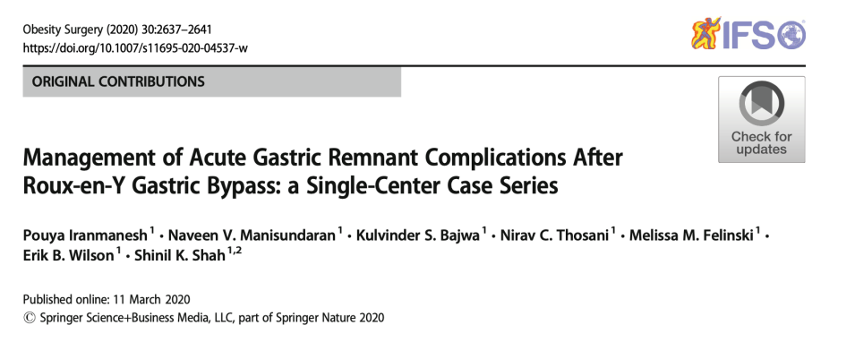
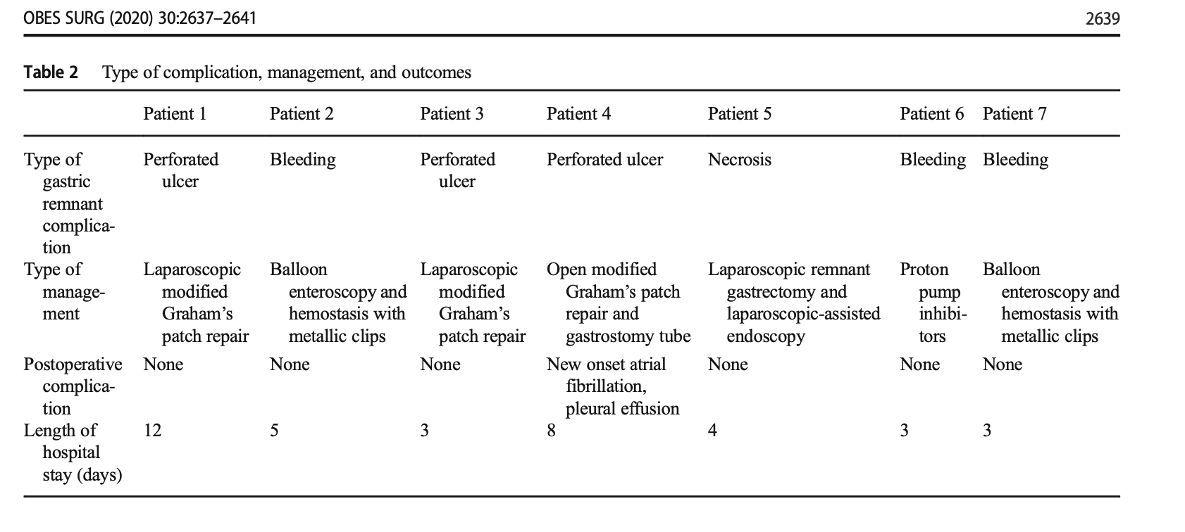
Acute remnant complications after RYGB: management

Slide 12
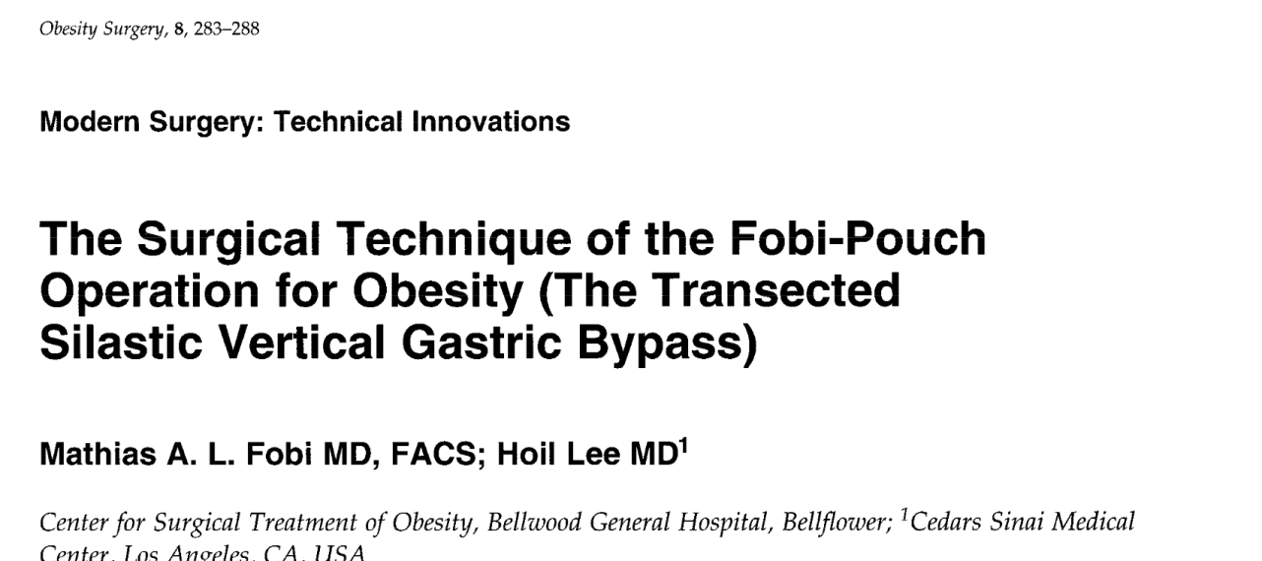
1998

Slide 13
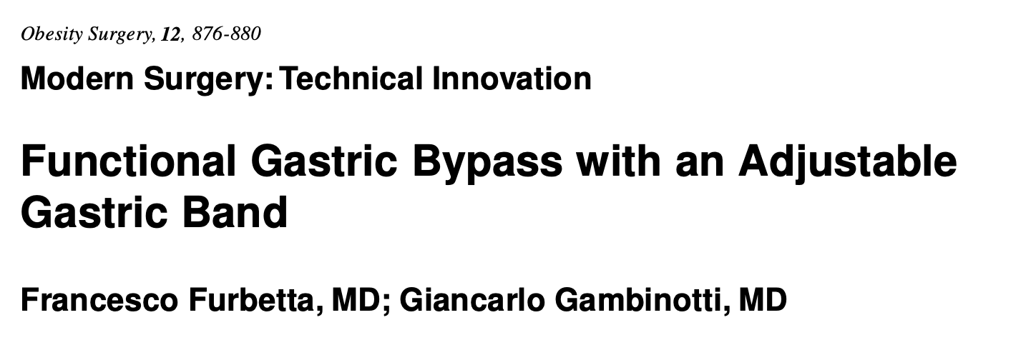
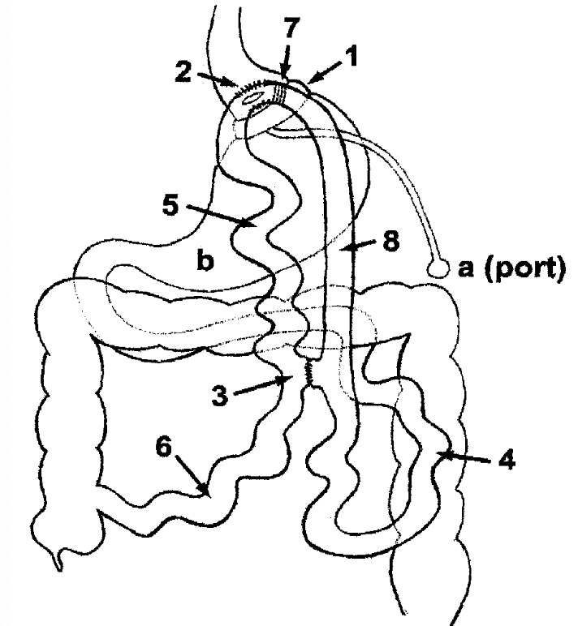

Slide 14
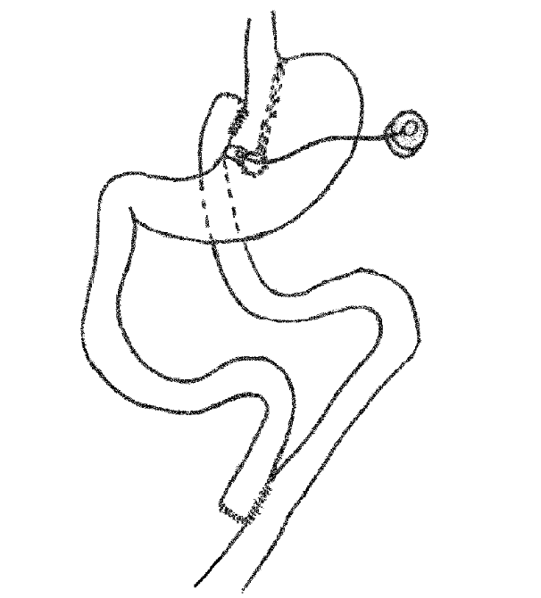
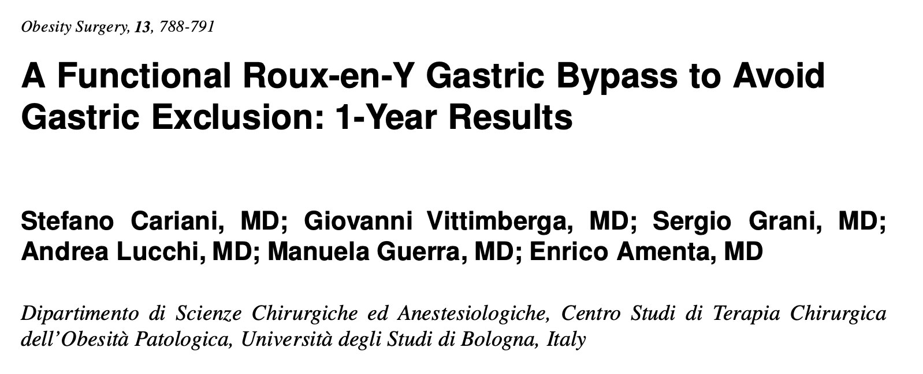

Slide 15
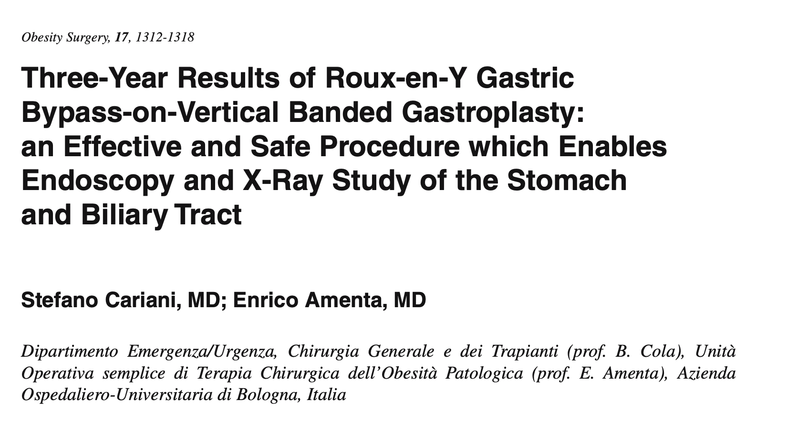
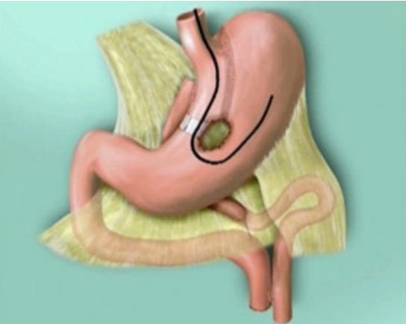
Mozzi E, Lattuada E, Zappa MA, et al. Failure of gastric bypass following several gastrointestinal hemorrhages. Obes Surg.
2010;20:523–5.

Slide 17
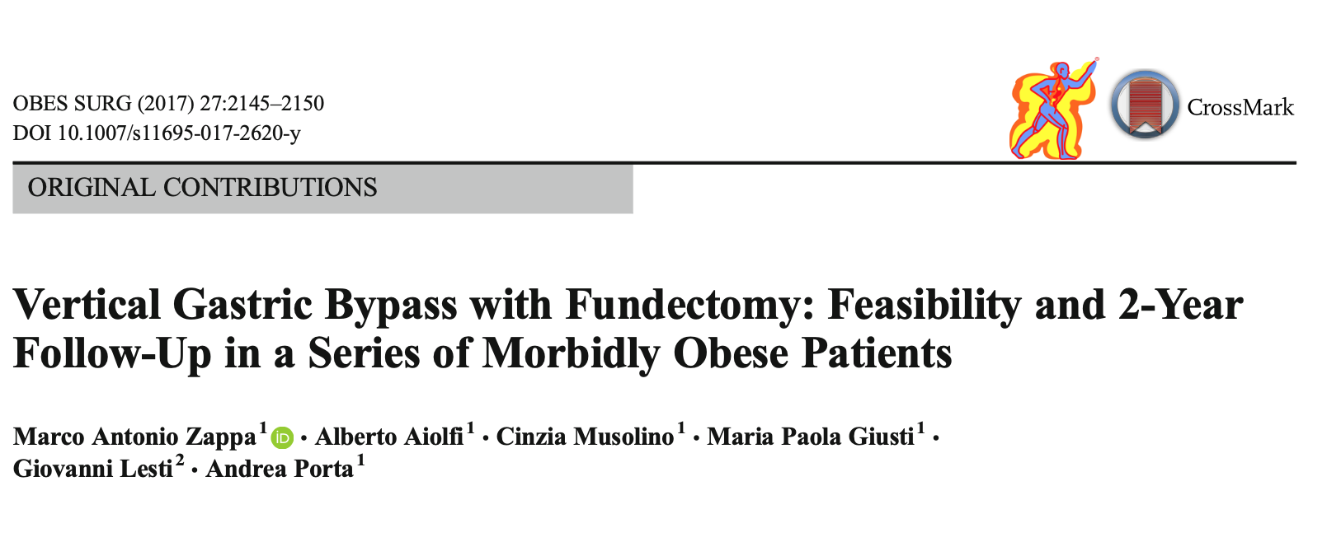

Slide 18
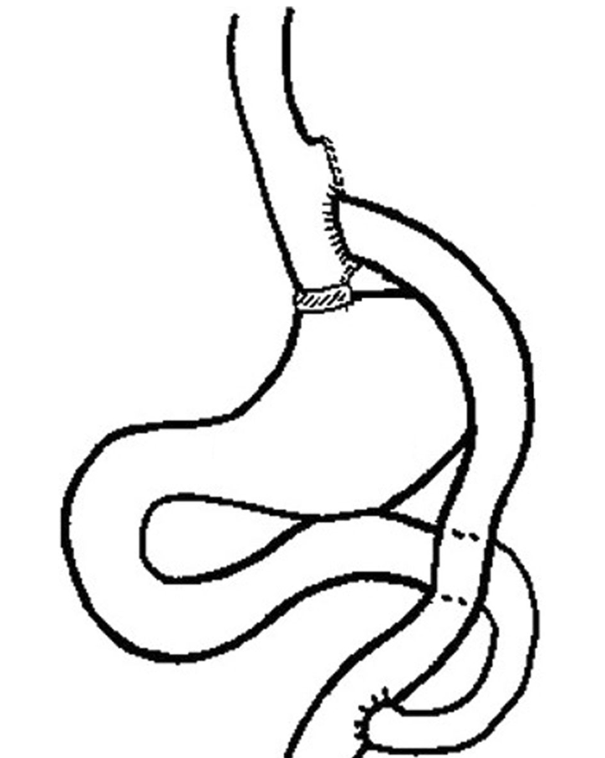
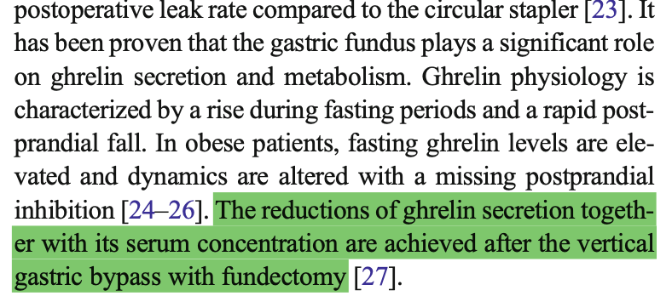
Fundectomy and Ghrelin

Slide 19
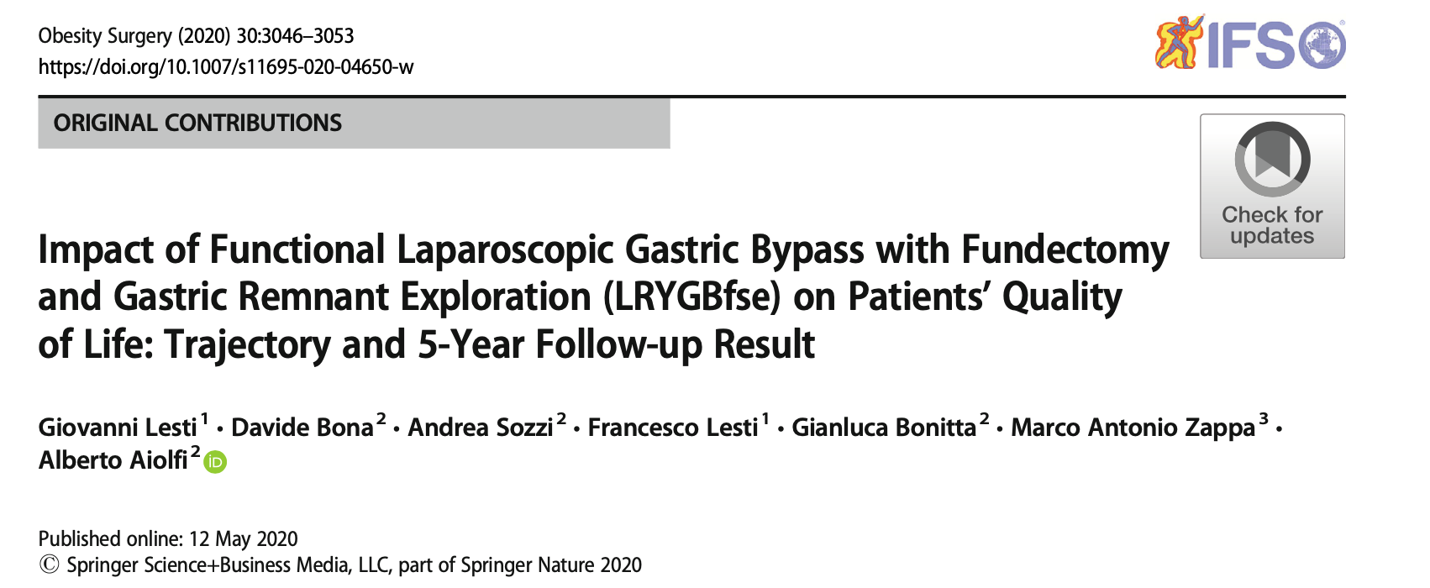
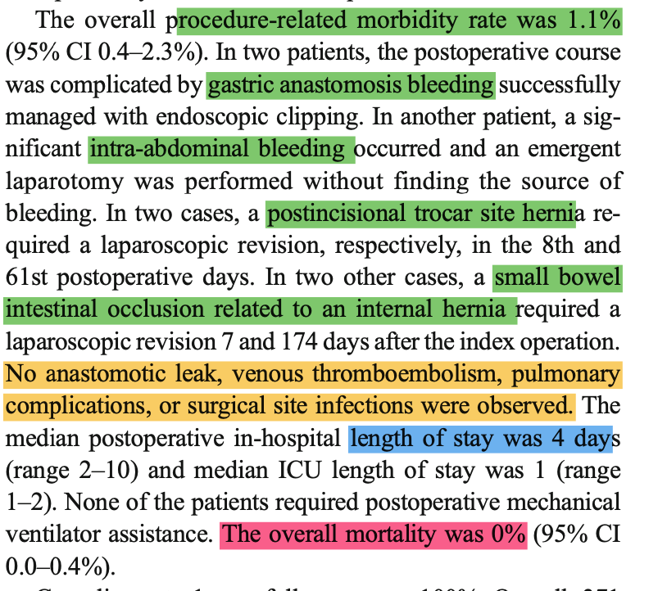
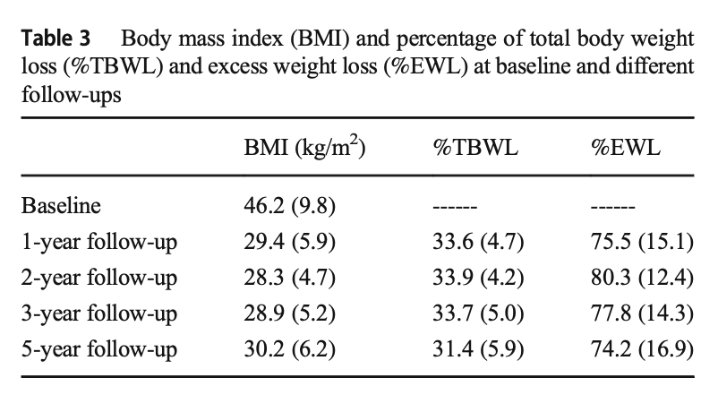

Slide 20
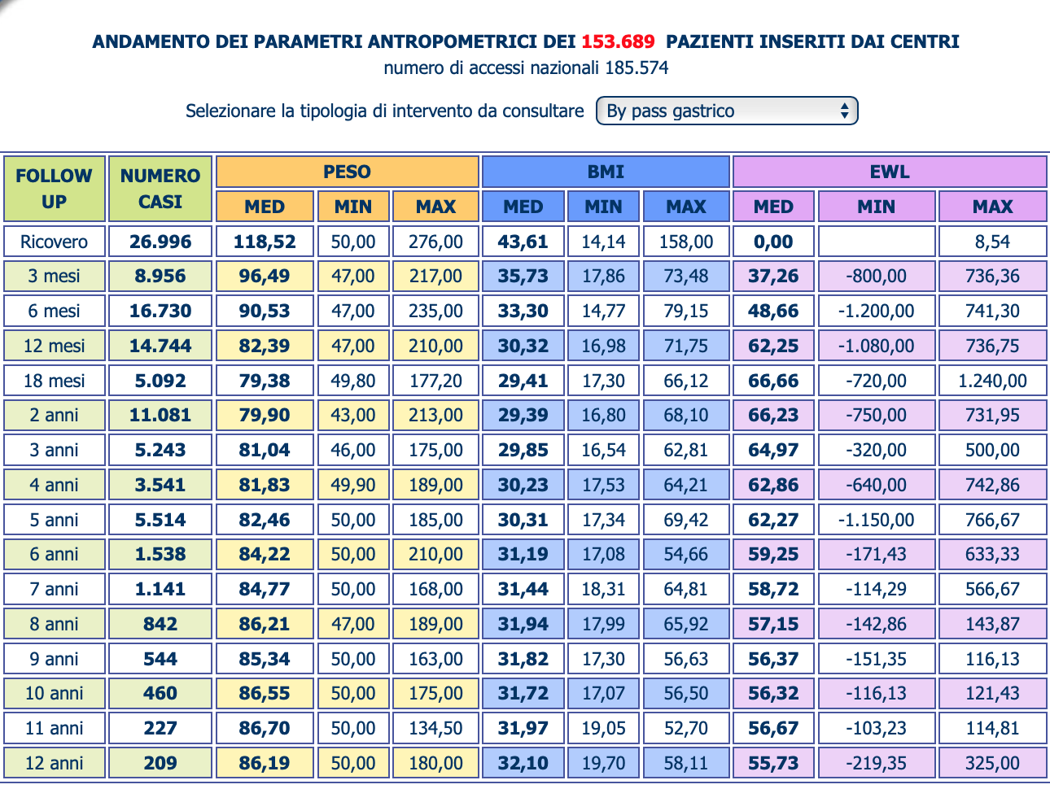
Lesti-Zappa
RYGB

Slide 21
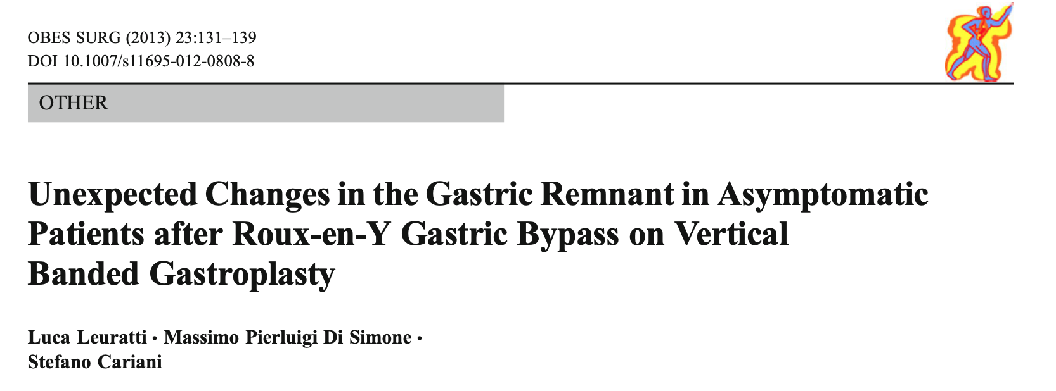
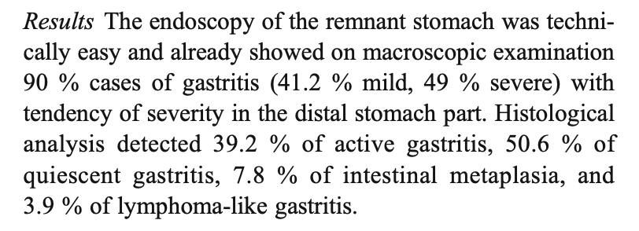

Slide 23
Da luglio 2021 a Dicembre 2023: 149 interventi
Chirurgia Generale Riccione

Slide 24
Chirurgia Riccione: bypass gastrico con fundectomia e stomaco esplorabile
-maggio 22 –dicembre 2023: 98 interventi
-(78 F, 20 M)
-eta media 46
-72 primo intervento, 26 redo
-BMI medio pre 41.77
-peso medio pre 115 kg
-degenza media 3 gg
-tempo operatorio medio: 131 minuti
-1 conversione
-EW preop 57 kg
EWL 1 mese 16.4
EWL 3 mesi 32.9
EWL 6 mesi 49.8
EWL 1 anno 57.7
Solo primo intervento 72 pz
EWL 1 mese 17
EWL 3 mesi 33.1
EWL 6 mesi 49.7
EWL 1 anno 56.4

Slide 25
Chirurgia Riccione: bypass gastrico con fundectomia e stomaco esplorabile
Complicanze < 30 gg. 5/98 (4.9%)
-1 deiscenza sutura verticale
-1 torsione anastomosi piede d’ansa (reintervento)
-2 insufficienza resp acuta al risveglio
-1 inf accesso trocar
-1 ernia ombelicale strozzata
Complicanze >30 gg 2/98 (2%)
1-ernia interna Petersen a 1 anno
1-nausea
Readmission
<30 gg 8/98 (7.8%) (3 dolore addomianle, 1 febbre, 1 suboccl, 1 deiscenza sutura verticale, 1 disidratazione, 1 necrosi omentale)
>30 gg 2/98 (2%) (nausea, ernia di Petersen )

Slide 26
ERABS
-no SBG
-no CV
-no drenaggi di routine
-mobilizzazione nel pomeriggio
-dieta semiliquida alla sera dell’intervento
-RX TD in 1 POD (solo a scopo documentale…)
-dimissione al pomeriggio di 2 POD
-consulto telefonico tutti i giorni fino al 1 controllo ambulatoriale in 7 POD

Slide 27
Bypass gastrico con fundectomia e stomaco eplorabile
vantaggi
svantaggi
-stomaco, duodeno e via biliare esplorabili (pz giovani!)
-calo ponderale > RYGB
-risultati in termini di risoluzione comorbilita e qualita di vita uguali o superiori rispetto a RYGB
-complicanze e mortalita non superiori al RYGB
-tecnicamente piu complesso
-tempo operatorio piu lungo
-costi superiori rispetto al RYGB (piu ricariche e benderella)
Perché non preferirlo al RYGB?

Slide 28
Grazie

